Slide 1
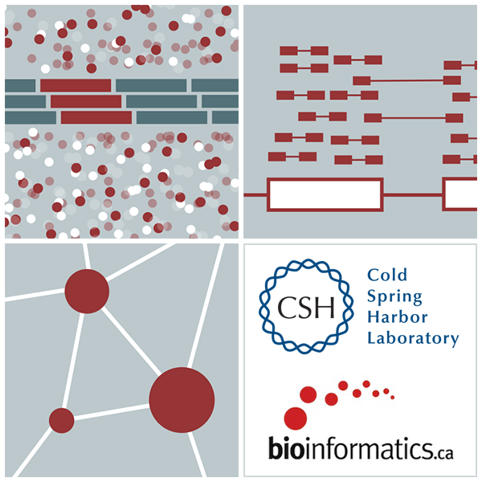

RNA-Seq workshop Single Cell RNA-sequencing
Kelsy Cotto, Malachi Griffith, Obi Griffith, Chris Miller, Megan Richters
Workshop icon

Slide 2
Single Cell RNA-sequencing
Single cell sequencing is not new
Doing it for a reasonable cost, at scale is

Slide 3
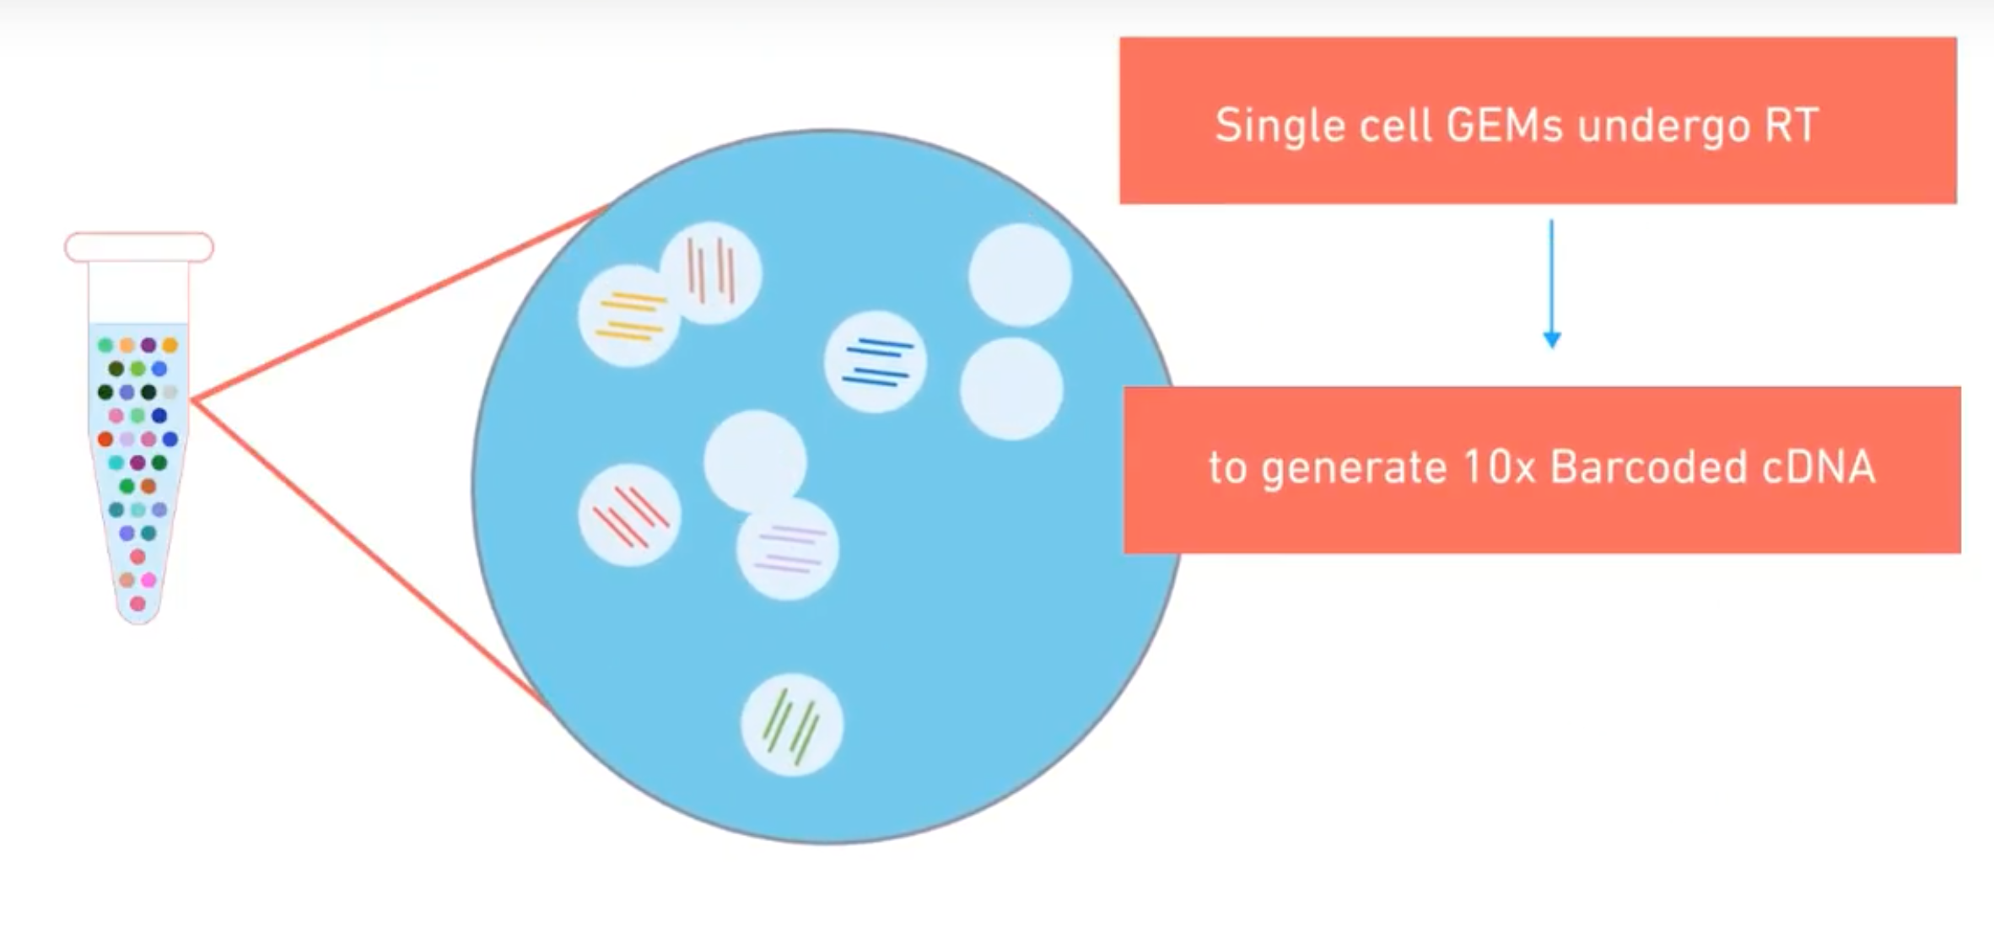
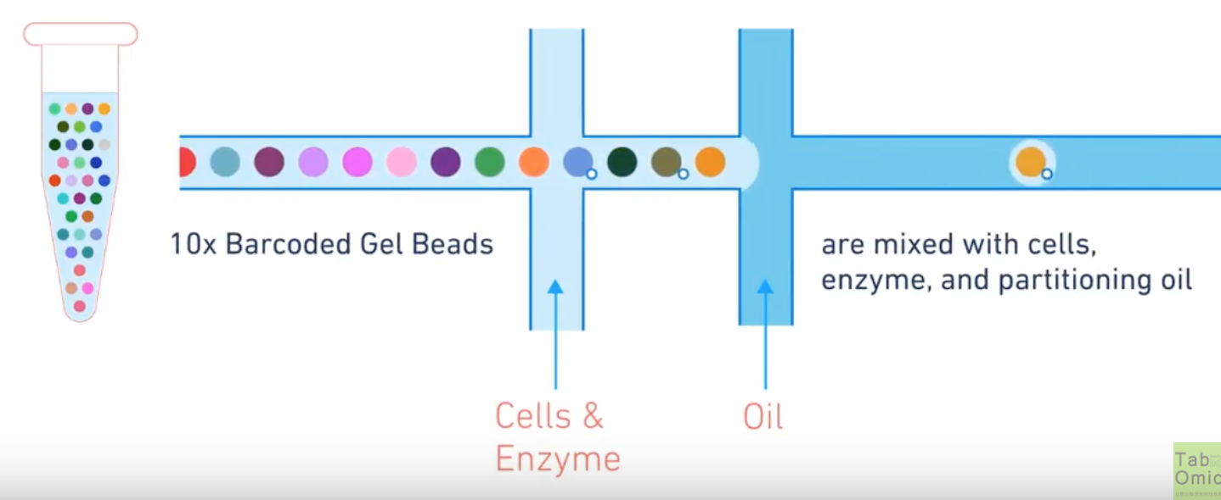
Library preparation and Sequencing
Cells are captured in oil droplets
Reactions in the droplets create the library and amplify it
cDNA is collected and sequenced
https://www.10xgenomics.com/solutions/single-cell/

Slide 4
Sequence data
Aligned with CellRanger (uses STAR under the hood)
Each read contains a pair of barcodes:
Cell Barcodes (CB) - Reads came from the same cell
UMI Barcodes (UB) - Reads came from the same molecule
Data is quite sparse
not every transcript is detectable in every cell

Slide 5
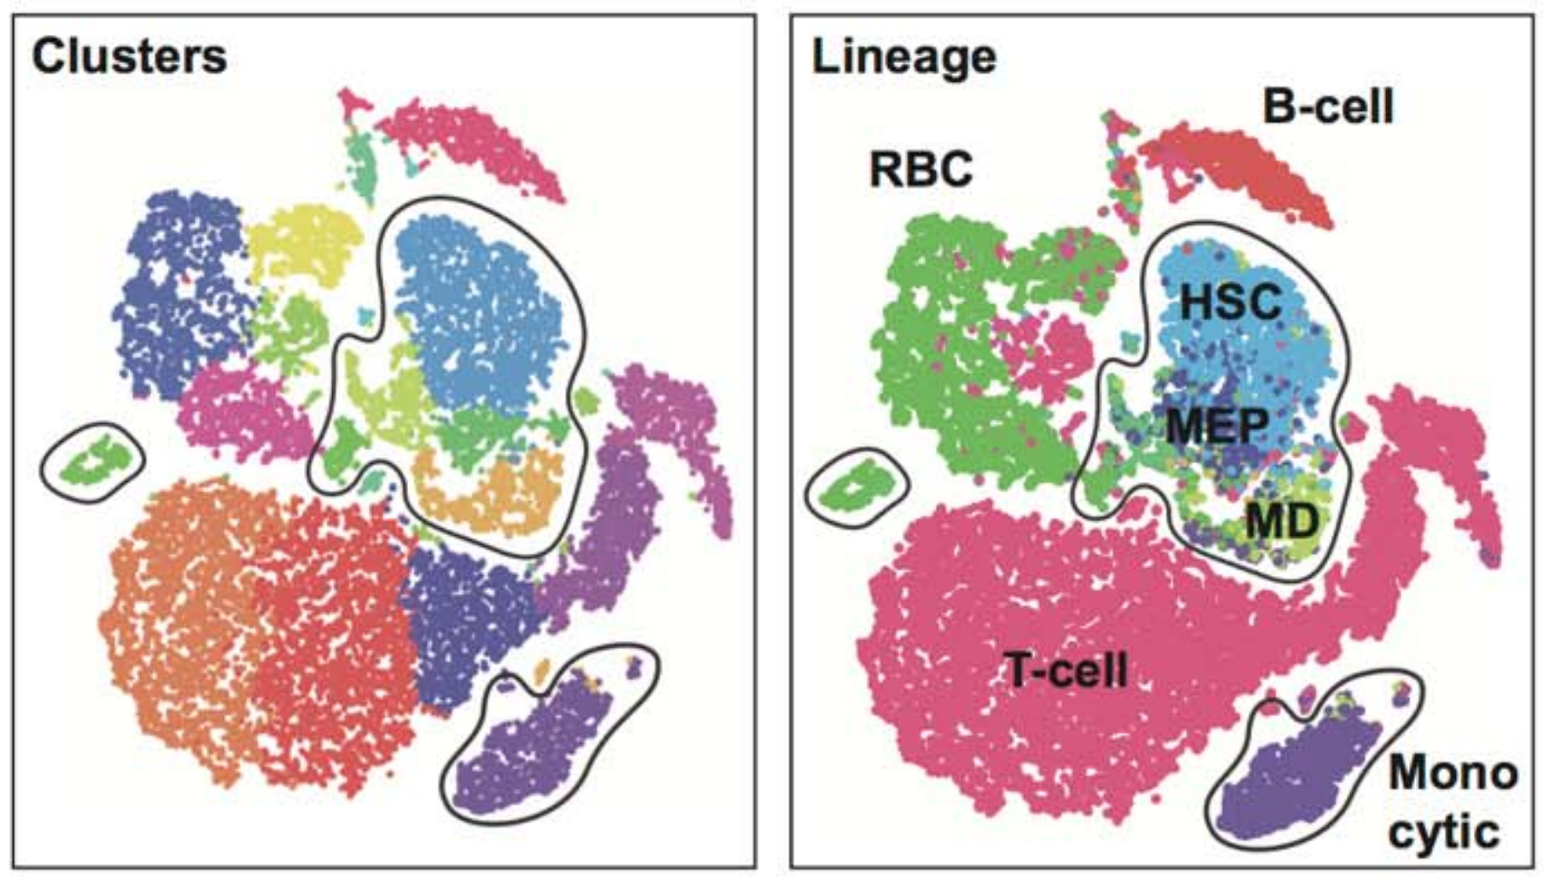
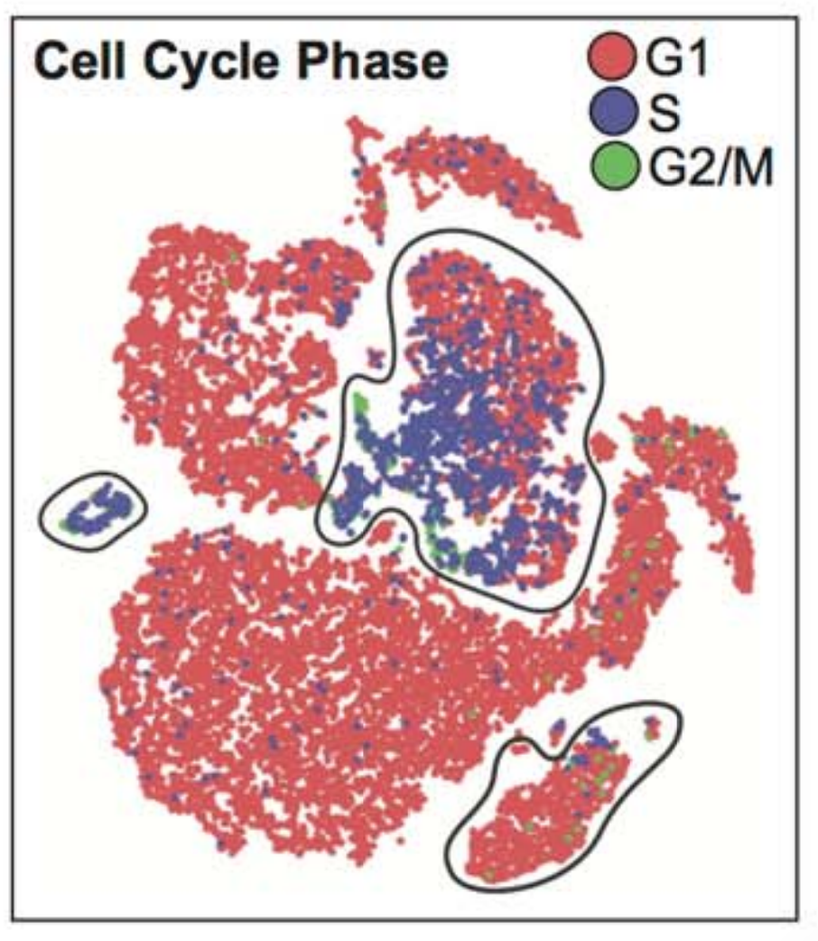
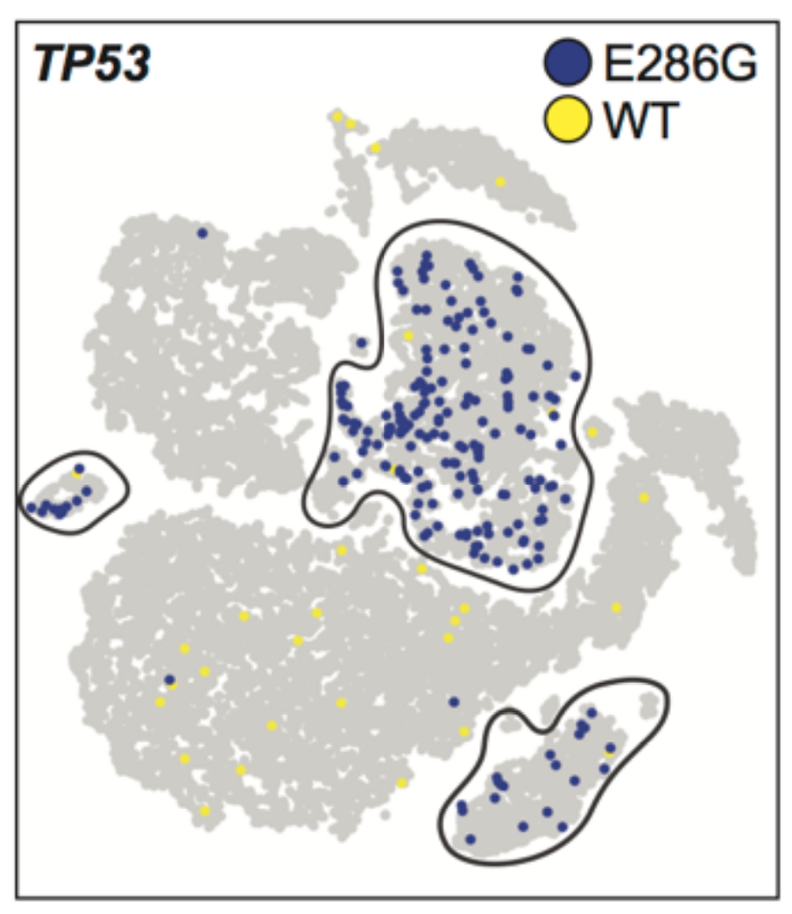
Single Cell Analyses
Clustering
Lineage Inference
Cell Cycle Markers
Mutation detection
Still a rapidly evolving field, but a few popular packages include CellRanger, Seurat, Monocle, CONICS, many more
https://github.com/seandavi/awesome-single-cell
Petti, et al. doi:10.1101/434746

